Slide 2
Building Silverlight & WPF Applications With Prism
Name: David Hill
Title: Principal Architect
Company: Microsoft Patterns & Practices
Session Code: DPR302
Notes:
Session Abstract: Prism provides guidance, via design patterns, to help you build robust, flexible and modular Silverlight and WPF applications. These patterns support unit testing, separation of concerns, loose coupling and the ability to share application logic between Silverlight and WPF applications. Prism includes source code for the library itself, extensive documentation, a sample application that shows how the patterns work together in a real-world application. It also includes a Visual Studio add-in to help you easily share code between WPF and Silverlight. This session provides an overview of Prism, and shows how you can use Prism to design and build composite Silverlight applications.

Slide 3
Agenda
What Is Prism and What Does It Do?
Client Application Challenges
What’s In The Box?
Modularity Patterns
UI Layout & Composition Patterns
Separated Presentation Patterns
Commanding & Eventing Patterns
Multi-Targeting

Slide 4
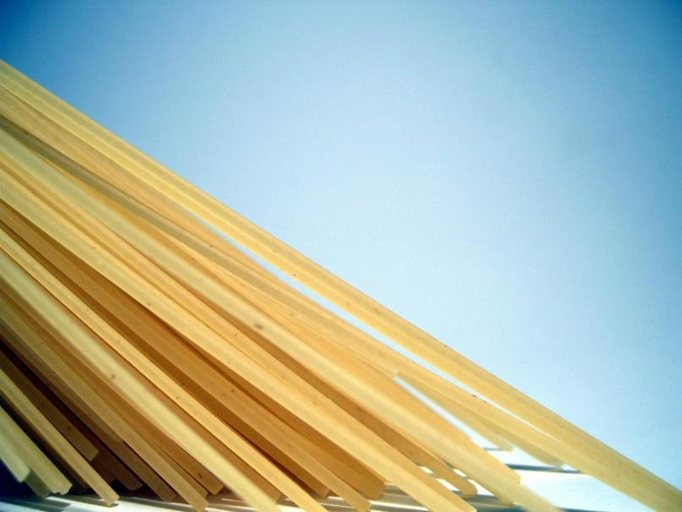

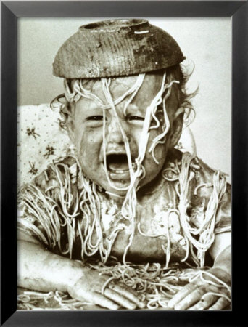
The Challenge
Notes:
http://www.sxc.hu/photo/833284
http://www.sxc.hu/photo/338544

Slide 5
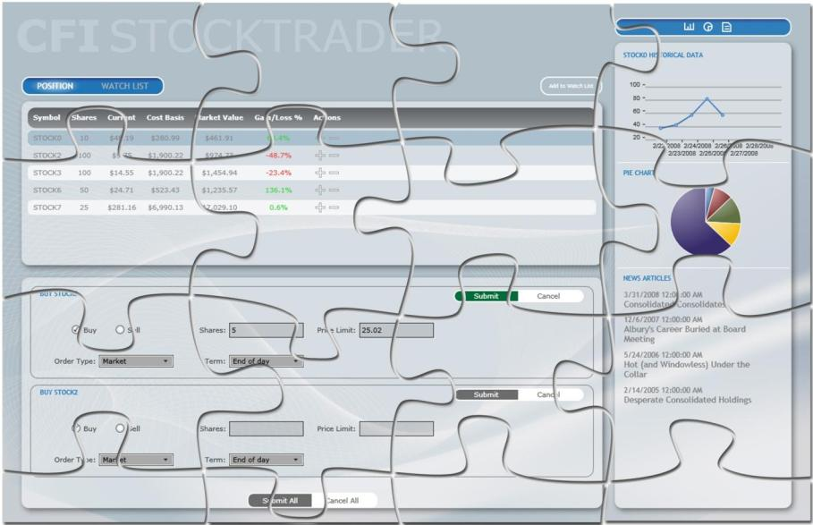
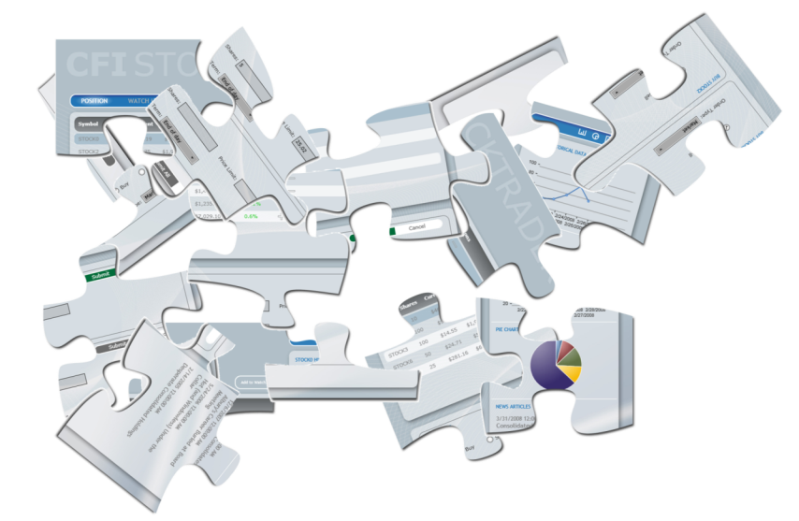
The Solution

Slide 6
Composite Client Applications
The Problem:
Client Applications are Challenging!
Beyond the Bling – How To Make The Application Dynamic, Customizable, Extensible, Testable?
The Solution:
Break App Into Pieces
Manage Dependencies Between Pieces
Re-assemble App From Pieces
Prism – Patterns For Composite Client Apps

Slide 7

Prism – What’s In The Box?
Prism – Composite Client Application Guidance for WPF and Silverlight
Library
Reference Implementation
Documentation
Quick-Starts & How-To’s
Community – CodePlex
Prism 1.0 – WPF
Released July 2008
Prism 2.0 – WPF & Silverlight
Released Feb 2009

Slide 8
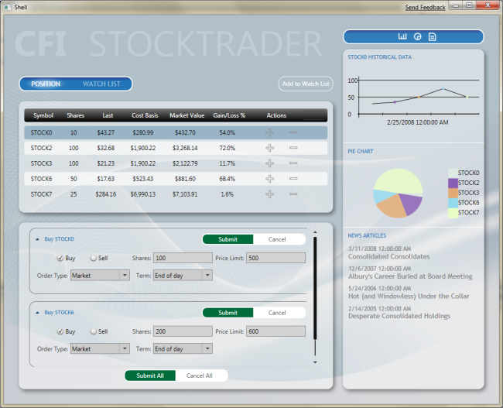
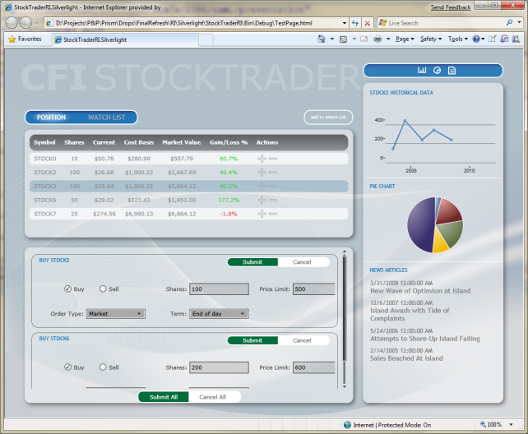
Prism Reference Implementation

Slide 9
The StockTrader Reference Implementation
demo

Slide 10
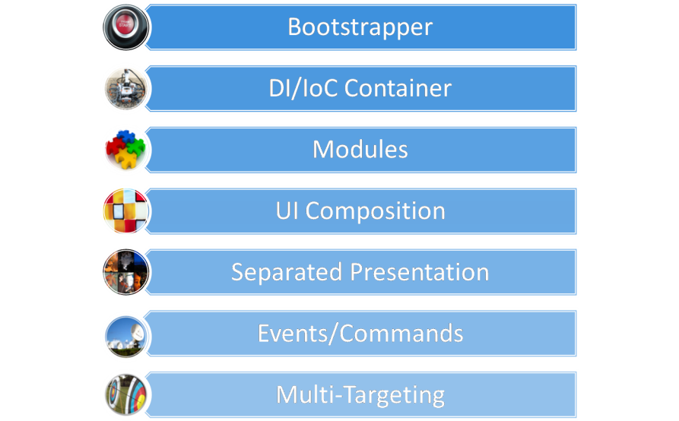
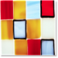

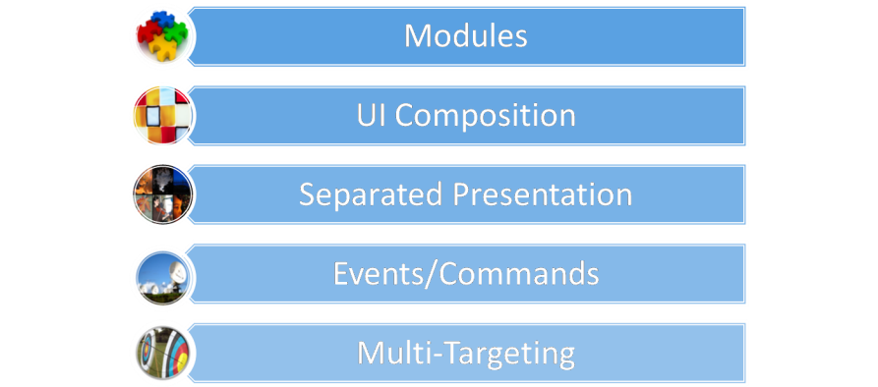
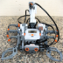




Prism Core Concepts

Slide 11

Modules
Unit Of Application Assembly
Collection of Related Components
Feature, Services, Views, Data Access
Slice & Dice: Mandatory, Optional, Role Specific
Unit Of Development
Independent Development
Independent Testing
Unit Of Deployment
Up-Front, Background or On-Demand

Slide 12

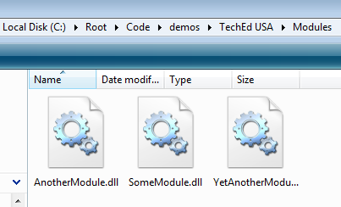
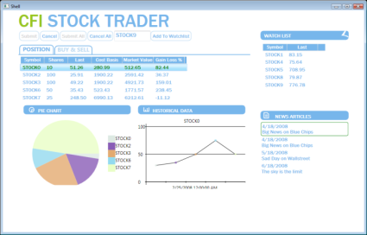





Modules
New In Prism 2.0!
Module Discovery
Pluggable Catalogs
Module Loading
Background or On-Demand
Module Loader

Slide 13
Modules and Catalogs
demo

Slide 14
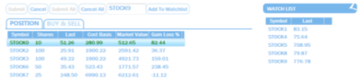
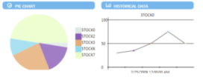
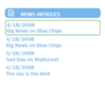
UI Layout & Composition
Shell – Application Host Window
Regions – Named Areas For View Placement
Views – Module UI & Presentation Logic
View Injection Visual Composition
IPositionPresentationModel presentationModel = …;
IRegion mainRegion = regionManager.Regions[ "MainRegion" ];
mainRegion.Add( presentationModel.View );
<ItemsControl RegionManager.RegionName= "MainRegion">
Region
<ContentControl RegionManager.RegionName= “DetailsRegion” />
Region
Region

Slide 15
UI Layout & Composition
View Discovery Visual Composition:
Less Complex
Black Box ‘App Assembly’ Composition
Select Views & Pull into Region
regionManager.RegisterViewWithRegion(
"MainRegion", typeof( MainView ) );
<ItemsControl RegionManager.RegionName= "MainRegion" RegionManager.AutoPopulate="True“ />
Region
<ContentControl RegionManager.RegionName= "DetailsRegion" RegionManager.AutoPopulate="True"/>
Region
Region

Slide 16
UI Layout & Composition
demo

Slide 17
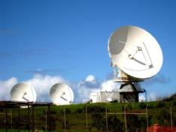
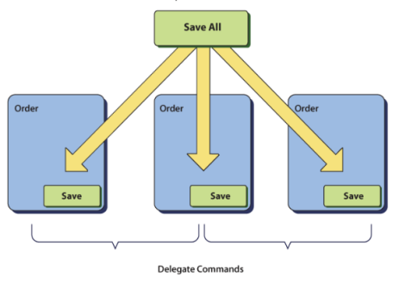
Commands and Events
Delegate & Composite Commands
Simplified Command Handling
Event Aggregator
Loosely Coupled Pub/Sub Events
Event Aggregator
Publish
Subscribe
Event
Module A
Module B
Order Presenter
Customer Presenter

Slide 18
Commands & Events
demo

Slide 19

Separated Presentation
Prism 1.0
Supervising Presenter
Presentation Model
Prism 2.0
More Concrete Guidance on Using These Patterns…
“Model-View-ViewModel”
How To Be Designer Friendly
Modeling Presentation State (Not UI State)
Ultra Thin Views – Data Templates
View
Presenter
Model
View
Presentation
Model
Model

Slide 20


Multi-Targeting
User Experiences
Desktop – In the Office, Full Functionality, Offline Capable
RIA – Out of the Office, Functional Subset, Online
How to Share Code & Components?
BROWSER
DESKTOP
SILVERLIGHT
WPF
Views
Views
Presenters
Presenters
Controllers
Controllers
Models
Models
BCL
BCL
CLR - Silverlight
CLR Desktop

Slide 21

Multi-Targeting: Strategies
Start With LCD – Silverlight
Separated Presentation Strategies
Single Source, Cross Compiled
Links and Parallel Project Structures
If Not:
#IF SILVERLIGHT
Partial Classes
Partial Methods
Separate Classes/Services

Slide 22
Multi-Targeting
demo

Slide 23
Summary
Prism 1.0
Library of Patterns for Enterprise Client Apps
Targets WPF on the Desktop
Prism 2.0
Extends Prism to Silverlight RIA Applications
Extended Patterns for UI Composition, Separated Presentation, Modularity
Multi-Targeting – Extend user experience & re-use code and components
Download from MSDN & CodePlex
Send us feedback & ideas for Prism 3.0!

Slide 24
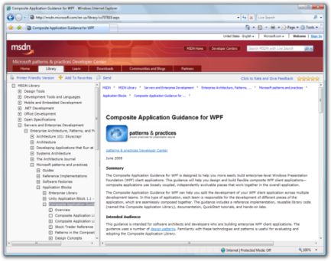
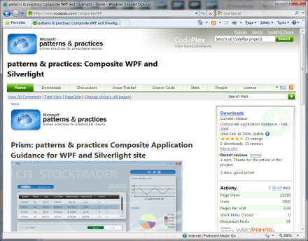
Where Can You Find It?
www.microsoft.com/prism
www.codeplex.com/prism

Slide 25
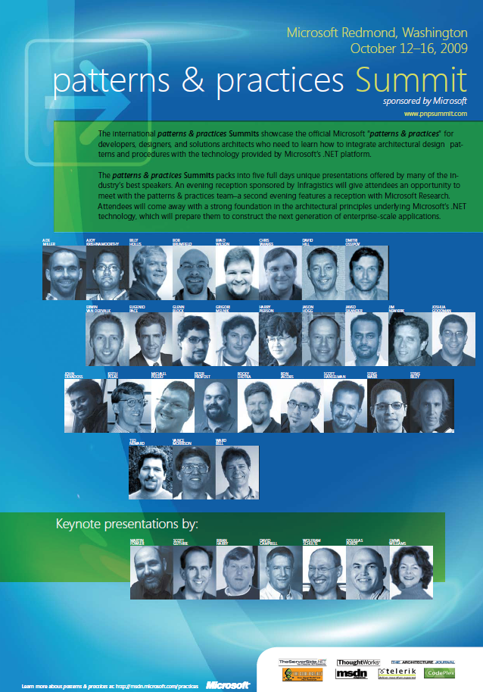
What Previous Attendees Have Said...
"Overall, conference was great, gave us good roadmap to follow."
"Thank you for all the great ideas. I am looking forward to going home and applying them."
"Many of the things I learned here will revolutionize our practices, processes, designs, and patterns. THANKS!"
"Speakers were great“
"Excellent conference, just first day alone was worth the money. Thank you."
"This was an excellent value and I would recommend it to everyone!!"
"All speakers were very knowledgeable and they addressed many issues that I face every day."
"This was an excellent conference for me. I'm taking away some useful tools.“
More information:
http://tinyurl.com/pnpsummit
Facebook: Stay tuned to updates on p&p summit by becoming a fan of p&p summit in Facebook. Click here to become a fan.
Digg It: Show you support, by digging the p&p summit announcement here.
Twitter: In your tweets about p&p summit, please add the tag “#pnpsummit”.

Slide 26
question & answer

Slide 27




Resources
Required Slide
Speakers,
TechEd 2009 is not producing
a DVD. Please announce that
attendees can access session
recordings from Tech-Ed website. These will only be available after the event.
Tech·Ed Africa 2009 sessions will be made available for download the week after the event from: www.tech-ed.co.za
www.microsoft.com/teched
International Content & Community
www.microsoft.com/learning
Microsoft Certification & Training Resources
http://microsoft.com/technet
Resources for IT Professionals
http://microsoft.com/msdn
Resources for Developers

Slide 28
Related Content
Required Slide
Speakers,
please list the Breakout Sessions, TLC Interactive Theaters and Labs that are related to your session. Any queries, please check with your Track Owner.
Breakout Sessions (session codes and titles)
Whiteboard Sessions (session codes and titles)
Hands-on Labs (session codes and titles)

Slide 29
Track Resources
Required Slide
Track Owners to provide guidance.
Please address any queries to your track owners.
Resource 1
Resource 2
Resource 3
Resource 4

Slide 30

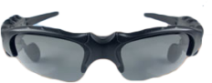
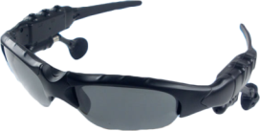
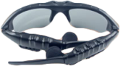
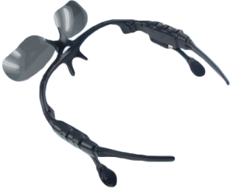
Required Slide
10 pairs of MP3 sunglasses to be won
Complete a session evaluation and enter to win!

Slide 31

Required Slide
© 2009 Microsoft Corporation. All rights reserved. Microsoft, Windows, Windows Vista and other product names are or may be registered trademarks and/or trademarks in the U.S. and/or other countries.
The information herein is for informational purposes only and represents the current view of Microsoft Corporation as of the date of this presentation. Because Microsoft must respond to changing market conditions, it should not be interpreted to be a commitment on the part of Microsoft, and Microsoft cannot guarantee the accuracy of any information provided after the date of this presentation. MICROSOFT MAKES NO WARRANTIES, EXPRESS, IMPLIED OR STATUTORY, AS TO THE INFORMATION IN THIS PRESENTATION.

